Slide 1
OWASP Korea Day 2019 SQL Injection 최신 취약점 사례
OWASP Seoul Chapter
세미나분과 유현수 팀장
n3oism@gmail.com
2019. 11. 02

Slide 2
Agenda
What is SQL Injection
Real World Case Studies
- Time Based SQL Injection
- Prepared SQL Injection
Q&A

Slide 3

What is SQL Injection

Slide 4
What is SQL?
1. What is SQL Injection
Def :
Structured Query Language designed for managing data held in a relational database management system (RDBMS).
The scope of SQL includes data insert, update and delete, schema creation and modification, and data access control.

Slide 5
Definition of SQL Injection
1. What is SQL Injection
Def :
SQL Injection attacks are a type of injection attack, in which SQL Commands are injected into data-plane input in order to affect the execution of predefined SQL commands
Cause:
It is a flaw in “web application development“, it is not a DB or web server problem
Most programmers are aware of this problem
Lot of solutions posted on the internet

Slide 6
Type SQL Injection Attack
1. What is SQL Injection
Simple SQL Injection
Tautologies, logic manipulation
Stacking queries
Union queries
Command Injection
Error based
Rely on error messages being output to the screen
Blind SQL Injection
Content based attack,
Timing attack
SQL Injection
Error Based
Blind Based
Boolean Based
Time Based

Slide 7
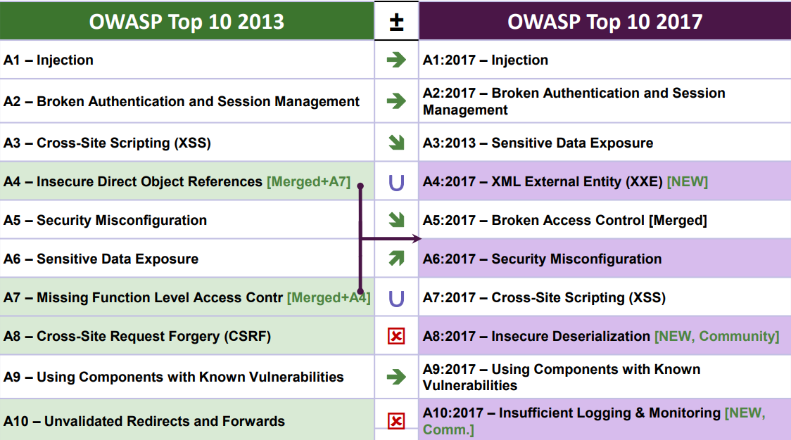
Injection the Biggest Hit
1. What is SQL Injection
Injection placed at the top of OWASP Top 10 since 2010

Slide 8
Many Types of Injection
1. What is SQL Injection
SQL Injection
Ability to insert arbitrary SQL commands in database queries
NoSQL Injection
Ability to insert arbitrary commands in a NoSQL DB Query
OS Command Injection
Ability to insert arbitrary commands in shell calls
LDAP Injection
Ability to alter the logic of an LDAP Query
Xpath Injection
Ability to alter the logic of an Xpath search

Slide 9
Injection Attacks
1. What is SQL Injection
Application passes data that has not been sanitized to an interpreter of some kind:
LDAP queries,
XPath
NoSQL queries
SQL queries
SMTP
Command interpreter

Slide 10
Real World Case Studies

Slide 11
Time-Based SQL Injection
2. Real World Case Studies
Blind SQL Injection
Program doesn’t return any visible data from database or data in error messages.
The attacker can’t see any data extracted from the database.
Time-Based SQL Injection
In scenarios with no differences between “True-Answer Page” and “False-Answer Page”, time delays could be use.
Injection forces a delay in the response page when the condition injected is True.
The time delay exploitation technique is very useful when the tester find a Blind SQL Injection situation, in which nothing is known on the outcome of an operation.
Time delay method:
Delay function
Heavy Queries

Slide 12
Time-Based SQL Injection - SCENARIO
2. Real World Case Studies
SQL Injection through HTTP Headers
UserAgent UserAgent is HTTP header which can be vulnerable to SQL injection once the application is storing it in database without sanitizing it.
Capturing Log Data
From WebServer
Log Analysis Software
Report
Capturing Log Data
From File Logs

Slide 13
Time-Based SQL Injection
2. Real World Case Studies
DEMO

Slide 14
Prepared Statement SQL Injection
2. Real World Case Studies
JDBC(Java Database Connectivity)
The JDBC Statement, CallableStatement, and PreparedStatement interfaces define the methods and properties that enable you to send SQL or PL/SQL commands and receive data from your database.
They also define methods that help bridge data type differences between Java and SQL data types used in a database.
Interfaces | Recommended Use
Statement | Use this for general-purpose access to your database. Useful when you are using static SQL statements at runtime. The Statement interface cannot accept parameters.
PreparedStatement | Use this when you plan to use the SQL statements many times. The PreparedStatement interface accepts input parameters at runtime.
CallableStatement | Use this when you want to access the database stored procedures. The CallableStatement interface can also accept runtime input parameters.
https://www.tutorialspoint.com/jdbc/jdbc-statements.htm

Slide 15
Prepared Statement SQL Injection
2. Real World Case Studies
PreparedStatement
A PreparedStatement object is used when an application plans to reuse a statement multiple times.
The application prepares the SQL it plans to use. Once prepared, the application can specify values for parameters in the prepared SQL statement. The statement can be executed multiple times with different parameter values specified for each execution.

Slide 16
Prepared Statement SQL Injection SCENARIO
2. Real World Case Studies
Are prepared statements 100% safe against SQL injection?
Using PreparedStatement with table name prepared statement is for the column values not for table name.
String strQuery = "INSERT INTO $tableName (col1, col2, col3, col4, col5) VALUES (?,?,?,?,?,?);";
String query = strQuery.replace("$tableName",tableName);
stmt = conn.prepareStatement(query);

Slide 17
Prepared Statement SQL Injection
2. Real World Case Studies
DEMO

Slide 18
Q&A

Slide 19
Q & A
3. Q&A

